Slide 1

Machine Learning for Predicting Epileptic Seizures Using EEG Signals
ENGR7028 – Engineering Project 1 (PG)
Student name: Hem Chaudhary
Student ID: 22106178
Supervisor: Ali Mehrabi
Western Sydney University
Oct 2025

Slide 2
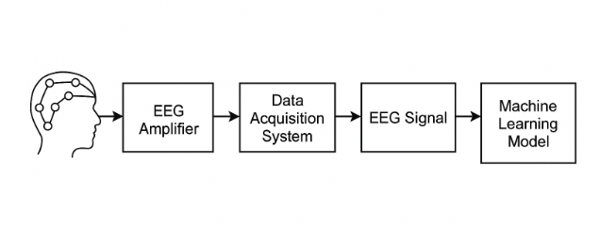
Introduction
Epilepsy affects 50M+ people globally.
Seizures are unpredictable and life-threatening.
Manual EEG interpretation is slow and impractical for real-time prediction.
Machine learning helps au mate seizure detection.
Previous research achieved high accuracy but poor generalization.
Basic process of EEG acquisition from scalp electrodes for seizure analysis

Slide 3
Aim and Objectives
Aim:
The aim of this project is to build a machine learning model in Python using the Random Forest Classifier and Random Forest Regressor.
Objective:
Use CHB–MIT EEG data.
Detect seizure and non-seizure segments.
Predict seizure start and end times.
Extract and analyze EEG features.
Visualize and evaluate model performance.
Identify limitations and future improvements.

Slide 4
Literature Review: Research Gaps and Panning
Research Study | Main Research Gap / Limitation | How I Plan to Solve It
Shoeb & Guttag (2010) | Model worked only for one patient — lacked generalization across people. | Expand dataset to include all 24 patients and apply epoch-based segmentation for better cross-patient training.
Ahmed et al. (2020) | Used manual feature extraction and assumed signals were constant over time. | model uses basic automatic feature extraction (mean, RMS, etc.). In the next stage, I plan to include preprocessing and epoch-based segmentation to handle changing EEG signals.
Chandel et al. (2022) | Reported very high accuracy on small, clean data, not real clinical signals. | Use real EEG data with noise; increase sample size and include diverse patient data.
Mourad et al. (2025) | Found no standard preprocessing or testing metrics across studies. | Apply standardized preprocessing, use consistent metrics (accuracy, MAE), and later add cross-validation.
General Literature (2020–2025) | Many models are complex and hard to interpret; results not explainable for doctors. | Use simple Random Forest model and plan to add feature-importance (SHAP) analysis for transparency.

Slide 5
Research Methodology
Data collection from CHB–MIT EEG database and importing in google colab
Data Preprocessing, labeling and separating seizure files
Feature extraction
Splitting for training and testing
Model training, predicting and testing
Visualization and comparing actual and predicted result

Slide 6
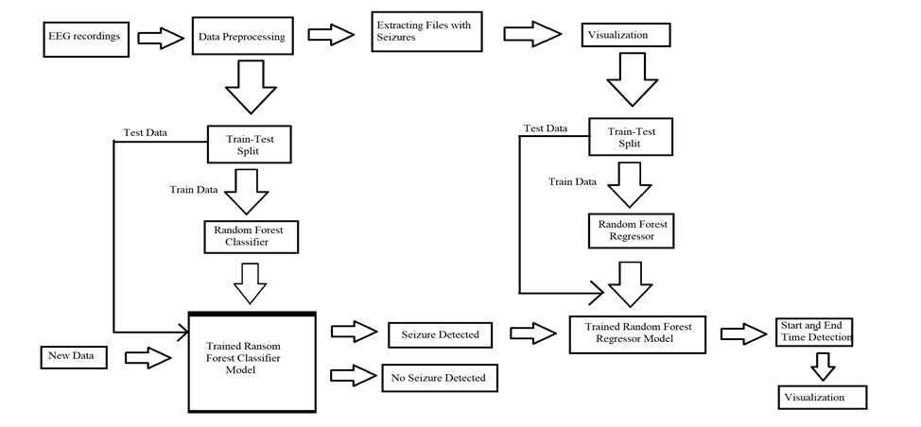
Workflow of the proposed machine learning model

Slide 7
Data Preparation and Feature Extraction
EEG recordings: 115 .edf files of 3 patients with 23 channels each
Tools used: Google Colab, MNE, NumPy, Panda, Glob, SciPy etc
Steps: Noise removal, filtering, labeling, cropping seizure sections
Extracted features: Mean, Variance, SD, Peak to Peak, max, min, RMS, Power, Skewness, Kurtosis, Absolute Differential Mean etc
Train Test Split: 90% for training, 10% for testing

Slide 8
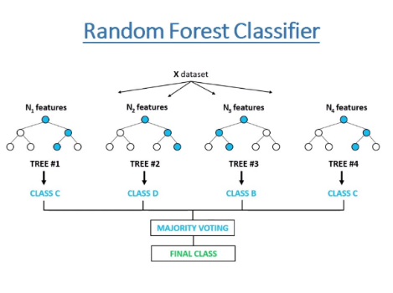
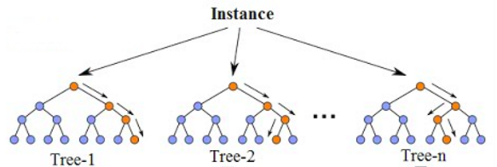
Research Methodology (Flow)
Random Forest Classifier:
Detects seizure vs. non-seizure EEG segments
Random Forest Regressor:
Predicts seizure start and end times of a file containing seizure
Random Forest Classifier (Source: freecodecamp.org)
Random Forest Regressor (Source: neptune.ai)

Slide 9
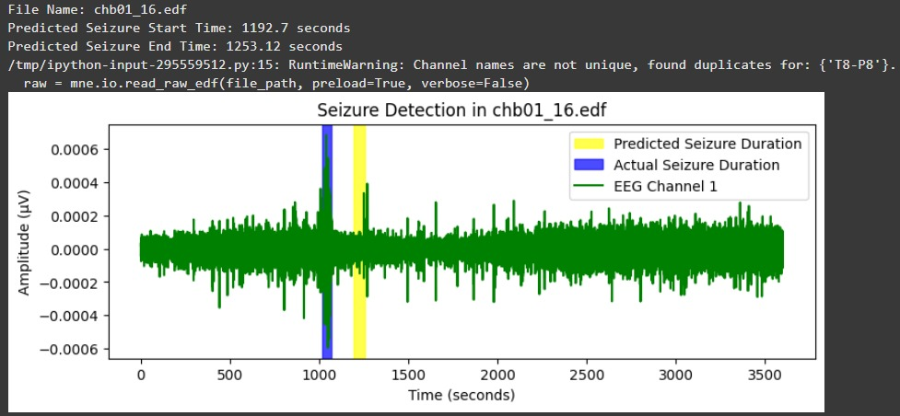
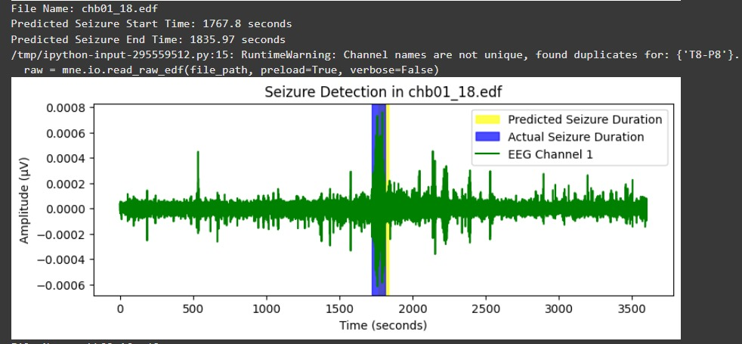
Training Results
Metric | Value
Accuracy | 100%
Avg. Start Error | 349.91 seconds
Avg. End Error | 342.67 seconds
Max Deviation | 848.88 seconds
Graphs showing seizure detection visualization for training data

Slide 10
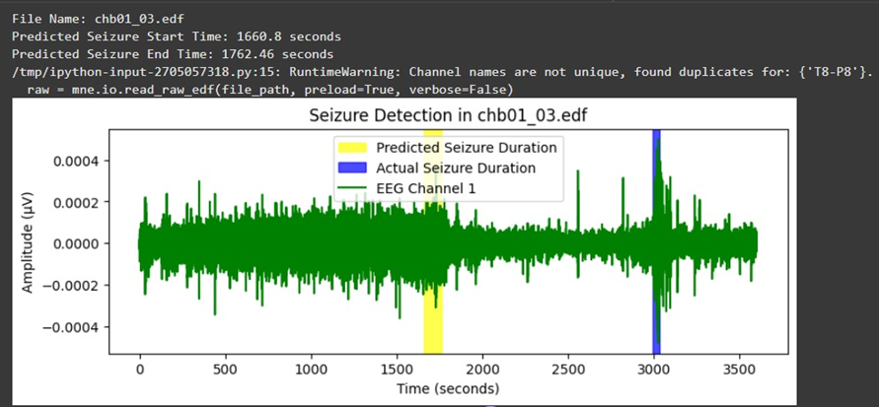
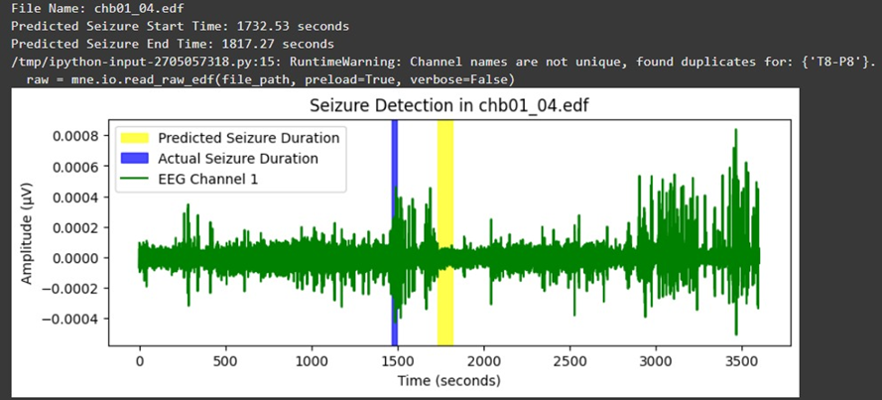
Testing Results
Metric | Value
Accuracy | 100%
Avg. Start Error | 800.37 seconds
Avg. End Error | 798.4 seconds
Max Deviation | 1335.2 seconds
Graphs showing seizure detection visualization for Testing data

Slide 11
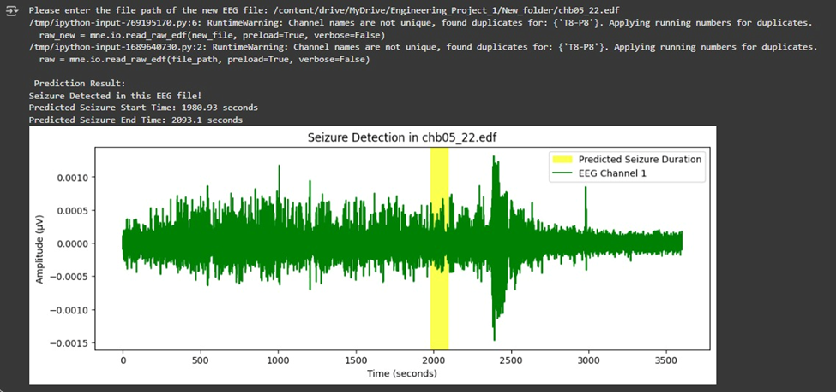
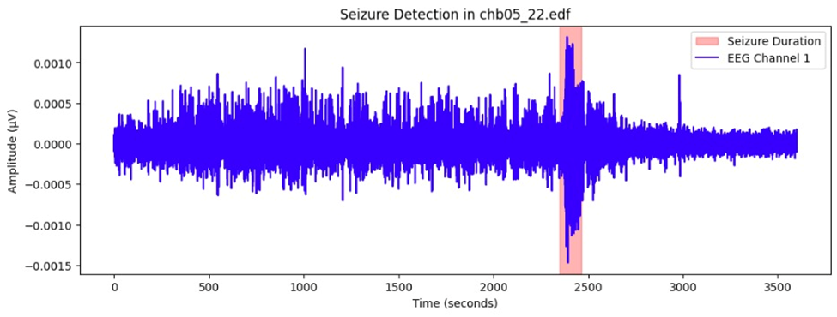
User Input Data and Seizure Labeling Process
A custom user-input module was developed to analyze new EEG files.
The system checks if the file contains seizure events using a dictionary-based labeling method.
For seizure-positive files, seizure start and end times are extracted.
Non-seizure files are automatically labeled as “0” (no seizure).
Output data is then passed to the Random Forest Classifier and Regressor for detection and timing prediction.
Testing signal plots showing actual seizure durations of a user input file
Testing signal plots showing predicted seizure durations of a user input file

Slide 12
Limitations and Future Work
Limitations:
Small dataset (3 patients only)
Timing offsets of 5–10 min
Detects only one seizure per file
Future Work:
Include 5 files from all 24 patients
Use 5–10 sec epochs
Detect multiple seizures
Optimize parameters

Slide 13
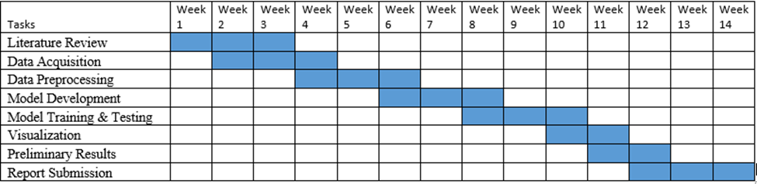
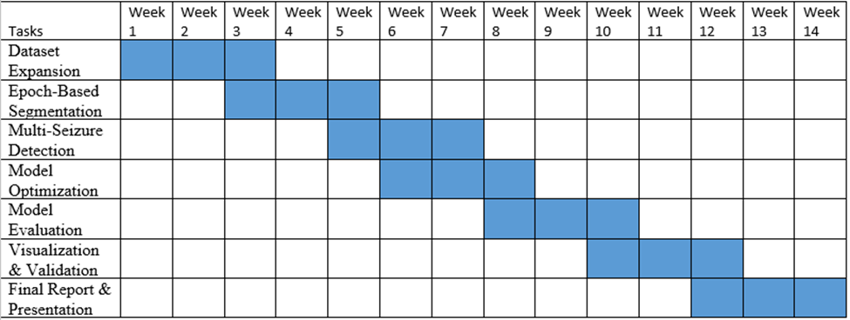
Research Plan & Timeline
Project 1:
(Completed) model development and preliminary testing
Project 2:
(Planned) dataset expansion, epoch segmentation, optimization

Slide 14
Conclusion
Random Forest model achieved 100% classification accuracy.
Regression results show good timing prediction with room for improvement.
The system demonstrates the potential of traditional ML for EEG-based seizure prediction.
Future work aims to enhance accuracy and apply to larger datasets.

Slide 15
References
Shoeb, A.H. & Guttag, J. (2010). Application of machine learning to epileptic seizure detection. MIT.
Ahmed, M., Zhang, Y. & Jiang, J. (2020). Machine learning for EEG-based seizure detection. IEEE Access, 8, 47435–47445.
Chandel, G., Kumar, R. & Nigam, A. (2022). Analysis of EEG signals using Random Forest models for epilepsy detection. IEEE Transactions on Neural Systems and Rehabilitation Engineering.
Mourad, R., Soltani, M. & El-Hajj, A. (2025). Machine and deep learning methods for seizure recognition. Brain Research.
Tzallas, A.T., Tsipouras, M.G. & Fotiadis, D.I. (2009). Epileptic seizure detection in EEGs using time–frequency analysis. IEEE Transactions on Information Technology in Biomedicine, 13(5), 703–710.
Subasi, A. (2007). EEG signal classification using wavelet feature extraction and Random Forests. Expert Systems with Applications, 37(2), 233–238.

